Slide 1
計算機概論實習
Week III(2020/09/29)
Logic Operator and selection
Lab: EC 118
助教:
陳作源 russchen.cs08g@nctu.edu.tw
陳彥銨 my91015.cs08g@nctu.edu.tw
鄭智仁 king601012003.cs08g@nctu.edu.tw

Slide 2
If…else…
開始
False
False
if
判斷條件
else if
判斷條件
True
True
if
敘述
else if
敘述
else
敘述
結束

Slide 3
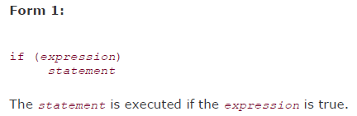

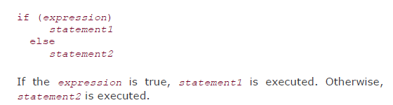
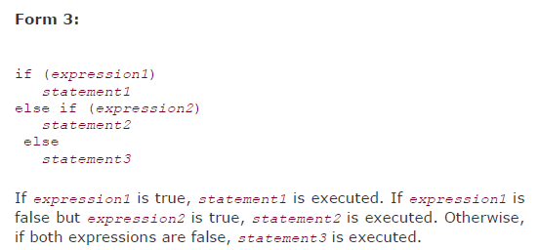
Using if Statements for Making Choices

Slide 4
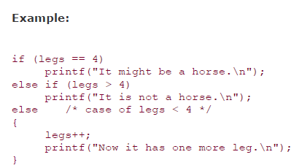
Using if Statements for Making Choices

Slide 5
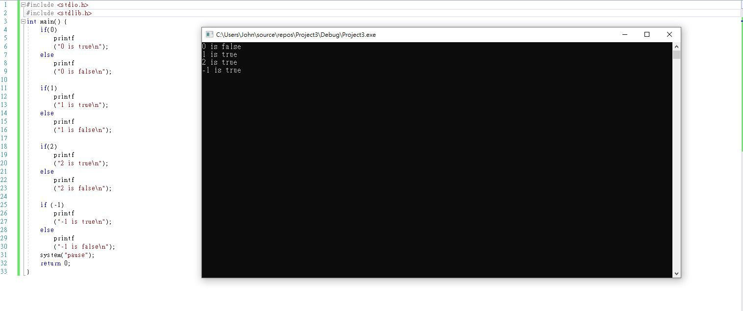
Using if Statements for Making Choices

Slide 6
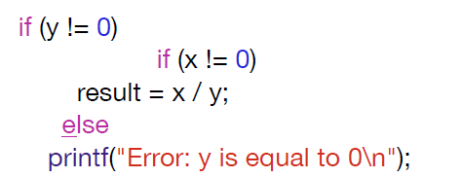
The “Dangling else” Problem
When if statements are nested, the “dangling else” problem may occur:

Slide 7
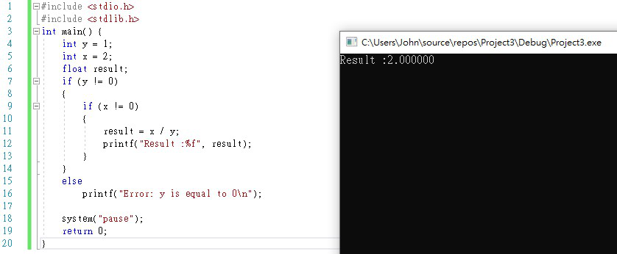
The “Dangling else” Problem

Slide 8
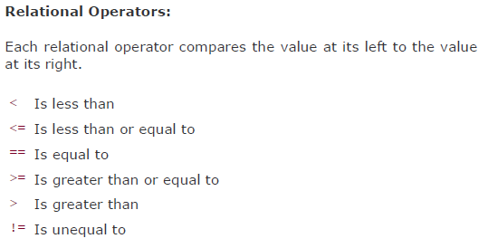
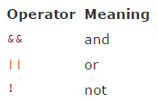

條件式判斷

Slide 9
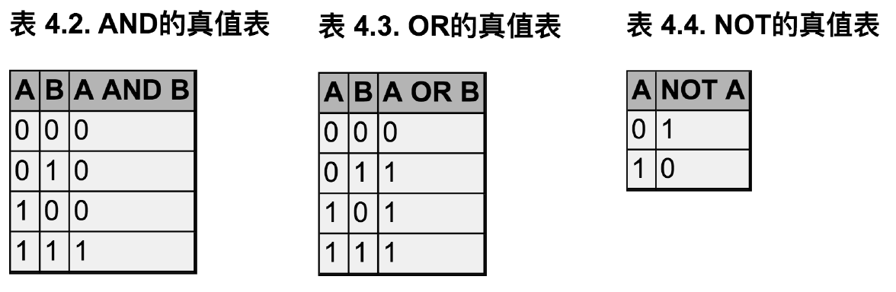
條件式判斷

Slide 10
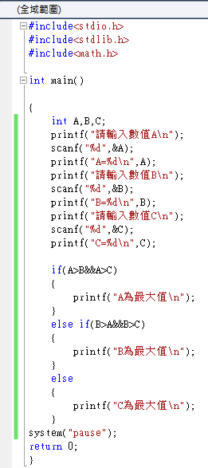
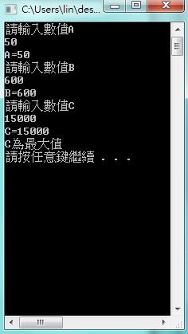
Example

Slide 11

Conditional Operator ？：
Example :

Slide 12
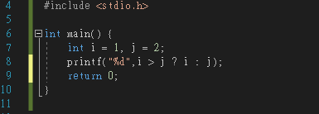
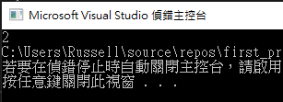
Conditional Expressions

Slide 13
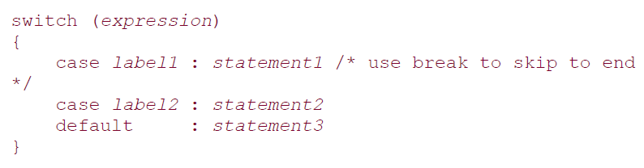
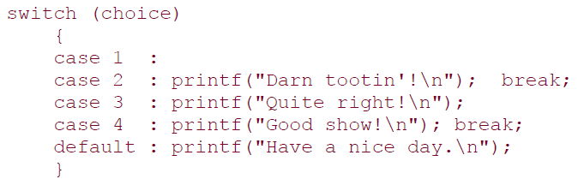
switch-case
Similar to if-else
more convenient to use the C switch statement when we have multiple case

Slide 14
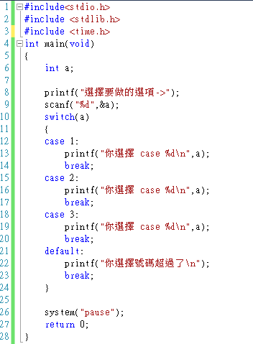
Example
int num;
switch(num) //數字
{
case 1:
printf(“number 1”);
break;
case 2:
printf(“number 2”);
break;
default:
printf(“none one of them”);
}

Slide 15
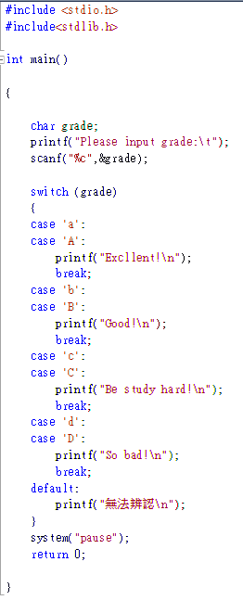
Example
char ch;
switch(ch) //字元
{
case ‘a’:
printf(“ ”);
break;
case ‘b’:
printf(“ ”);
break;
default:
printf(“無法辨認”);
}

Slide 16
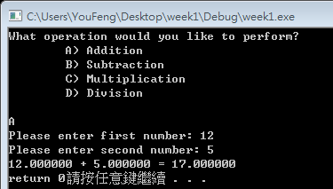

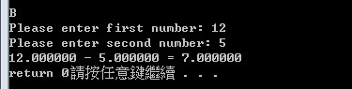
Exercise 1
First, user choose A、B 、C 、D to read the operation you would like to perform
Note : upper case and lower case are both accepted
User input two numbers
Output the answer based on the operation

Slide 17
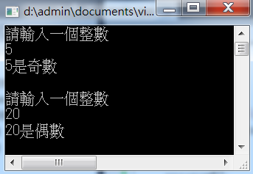
Exercise 2
Use switch case to determine that the
input integer is even or odd.

Slide 18


Exercise 3
Input a AD year (<2021)，if the year is a leap year.
Hint : Leap year occurs in years whose last two digits are evenly divisible by four, except for centenary years not divisible by 400.

Slide 19
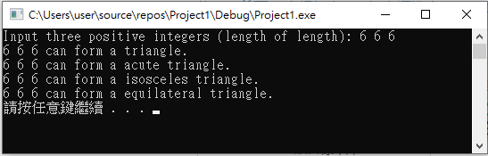
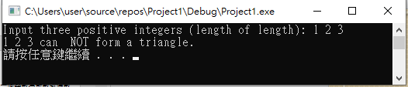
Exercise 4
Use scanf to read 3 integers — length of slides，you need to tell if these 3 slide length can form a triangle，and determine which triangle it is (right/直角 , obtuse/鈍角, acute/銳角 triangle，isosceles/等腰 triangle，equilateral/正 triangular)

